Slide 1
Application Portal in FLUID
SESSION 2050
16-10-2017

Slide 2
presenters
Roelof Conijn
Stefan van Liempt
Functional Consultant
Leiden University
R.Conijn@sea.leidenuniv.nl
Senior Consultant
CY2
Stefan@cy2.nl

Slide 3
AGENDA
PROJECT INTRODUCTION businessdrivers, current situation and challenges
PRODUCT OVERVIEW architecture, building blocks and more…
DEMO From applicant to student
CONCLUDING Q&A

Slide 5
In figures

Slide 7
Version
PS CS 9.0 (9.2 upgrade planned 2018)
Peopletools 8.55.13 bundle 41
Live since 2010 and continuously evolving
10 FTE functional team
Collaborating Higher Ed institutions: Leiden University, University of Amsterdam, Hogeschool van Amsterdam
Technical partner and hosting:

Slide 8
Project introduction

Slide 9
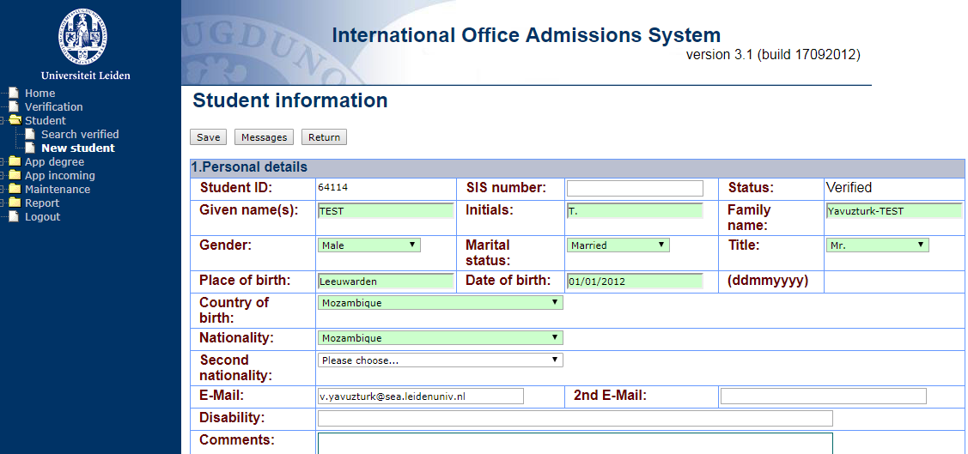
Current situation
Standalone database without interfaces (human interface)
With it’s outdated own UI

Slide 10
Why improve?
Internal:
Vulnerable application no longer fits within the IT landscape
Current process is inefficient (manual steps/matching)
Self service improvements for students necessary
Faster processing of admissions needed (competition for Int. students)
Management Info incomplete
External:
Changes in IND link (via Studielink) similair to UCAS
New Studielink architecture
Dutch developments for matching

Slide 11
Scope
Uploading of documents and additional information for student admission.
Online payment of application fee by students.
Register of housing request (via portal) by students (no extension or improvement).
Automated and registered communications to students.
Supporting visa process through national interface.
Credential evaluation of foreign diplomas.
Processing of admissions or rejections.
Registration of scholarships in uSis in a similar way as in OIEM (no extension or improvement).
Reports, queries, etc..

Slide 12
CHALLENGES
Finding the optimal UI experience
New Fluid technology
Translation of existing processes to functional designs: out of people’s heads into 0’s and 1’s
Translation of functional logic to technical design for developers
Project methodology

Slide 13
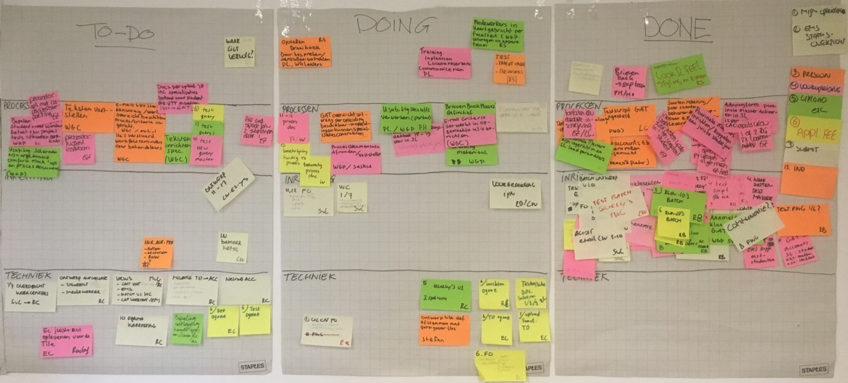
Project practices
Scrum vs Prince 2: best of both worlds?

Slide 15
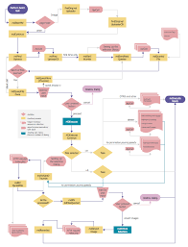
Product overview

Slide 16
Student
Studylink
Fluid Student Portal PeopleSoft
Classic Backoffice PeopleSoft
Igenico (Payment)
admission
Admission Studylink
Process Studylink admission
Check personal data
Verify
(re)-submit
Upload visa
accept
reject
Upload identity
(re)-submit
Upload Admission documents
Language
Prior Edu.
accept
reject
C.V.
Reference
Etc.
(re)-submit
Exemption
Bank
App Fee
accept
reject
Process Payment
Online
accept
reject
submit
Housing / Scholarships
(re)-submit
Upload conditional documents
Decision
accept
reject
accept
reject
later ..
Conditional Offer
Send
UnConditional Offer
Send
Decision
End

Slide 17
Building blocks
EMS (Evaluation Management System)
DOCUMENT MANAGEMENT (Upload functionality)
BATCH PROCESSING
USABILITY TOOLING (pagelets, workcenters, branding)
REPORTING (BI publisher)

Slide 18
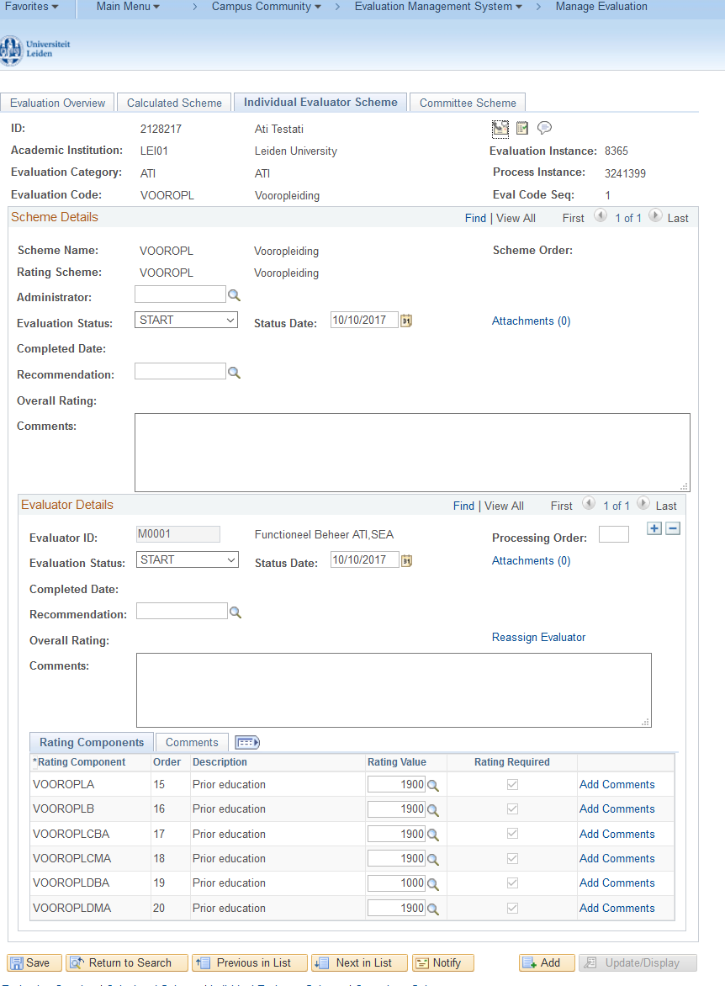
EMS

Slide 19
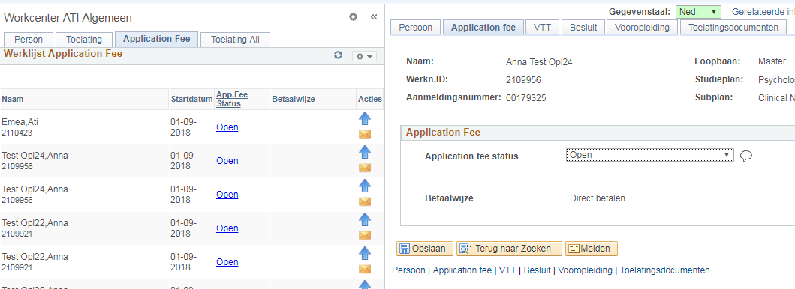
workcenters

Slide 20
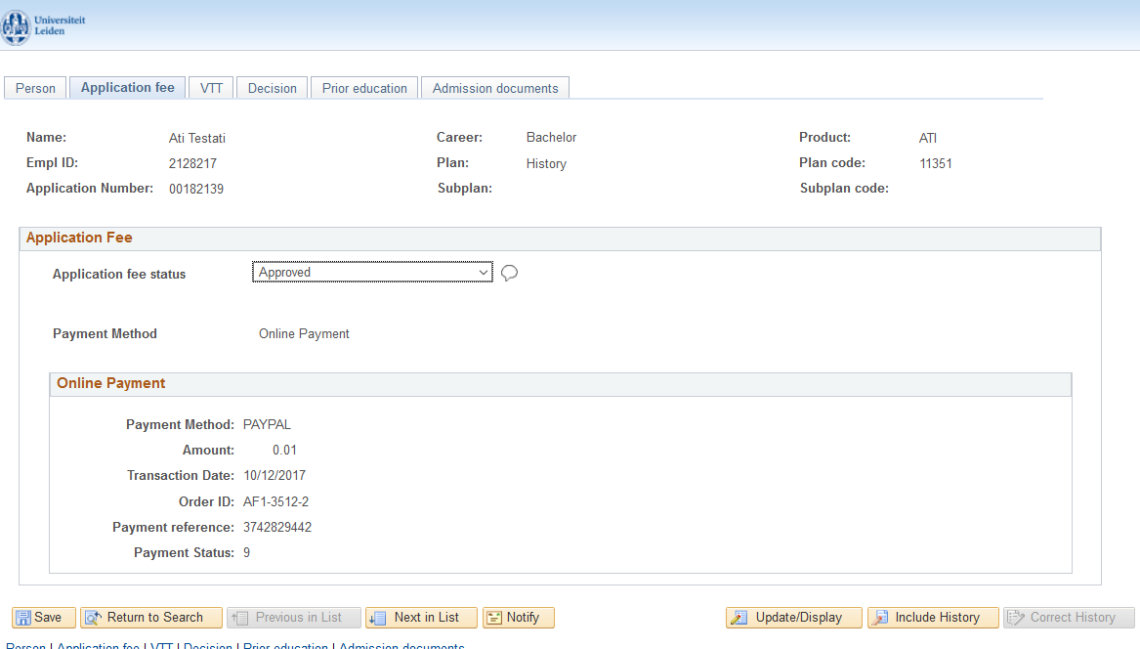
student FILE all relevant information in one dashboard

Slide 21
Customizations
Fluid
Student file screens
Interactions between component, portal and student file (CI heavy)

Slide 22
DEMO
SHORT DESCRIPTION

Slide 23
Concluding thoughts
EMS, Checklists or Custom tables?
Fluid or separate front end application with interfaces/webservices?
QUESTIONS?

Slide 24
COMING UP NEXT IN THIS ROOM
BRAND YOUR STUDENT SELFVICE FLUID HOMEPAGE!

Slide 25
presenters
Roelof Conijn
Stefan van Liempt
Functional Consultant
Leiden University
R.Conijn@sea.leidenuniv.nl
Consultant
CY2
Stefan@cy2.nl
all Alliance presentations will be available for download from the Conference Site

Slide 26
THANK YOU!

