Slide 1

Oracle’s Cloud Applications and the HEUG
EMEA 2017

Slide 2

HEUG’s mission of education and advocacy
…in a time of transition

Slide 3

Oracle’s expanding cloud product suite / ecosystem
Notes:
Financials, Planning & Budgeting, HCM & Taleo, CRM (Marketing, Sales, & Service Clouds), BICS, Integration Cloud Services, Student Cloud, and IaaS, DaaS and PaaS

Slide 4

Growing cloud adoption in Higher Education
Notes:
Australian Unis, BSU, U. Wyoming, Rutgers, Vanderbilt, U. Wisconsin, San Francisco State U., Lorain Country CC, Shawnee State, U. Md-Baltimore, U. System of NH, U. of Birmingham,

Slide 5
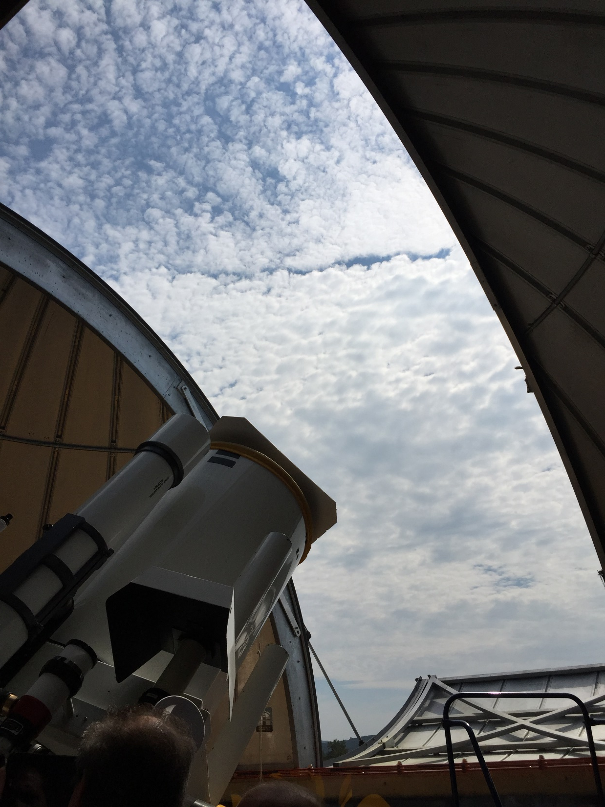
HEUG cloud focus areas
Fitness of applications for higher education
International support
Vendor relationship and procurement management
Notes:
Here are some cloud-related focus areas the HEUG board is considering. Some may be addressed by one or more Cloud advisory groups, some by the TAG, some by working groups, and some by the Board itself. Fitness of SaaS applications for use in higher education; Support for the international community, especially for local educational and regulatory structures; Understanding how licensing and product procurement

Slide 6
HEUG cloud focus areas
Configuration and extension
Integration management
Security and privacy

Slide 7
HEUG cloud focus areas
Change management
Skills for the future
?

