Slide 1
Usability 2.0: How to create advanced workcenters, dashboards and pagelets without AppDesigner
Session Number 5004
March 27, 2018

Slide 2
Mark van der Molen
Senior Functional Application Manager
University of Amsterdam
m.vandermolen@uva.nl
Carolien ten Oever
Senior Functional Analyst
University of Amsterdam
c.a.m.tenoever@uva.nl

Slide 3
> 100.000 students
> 10.000 administrative users
CS 9.0 (9.2 fall 2018)
PT 8.55
Bundle #41

Slide 4
Largest University of the Netherlands
One of the largest Research University’s in Europe
6.000 staff
32.000 students
5.600 international students (30% from outside EU, growth 30%)
62 Bachelor Programmes
137 Master Programmes
3.000 PhD Students – 550 promotions/year

Slide 5
Overview of this presentation
Introduction
Types WorkCenters – Basics / Configuration
Pagelets and how to customise them
Security
Branding
Tips & Tricks
Note: this presentation contains a lot of information

Slide 6
Workcenters
Access to related transactions, analytics data, query results from one central location.
Possibility to organise elements based on institution specific processes.
Basic:
Workcenter portal - browser windows in 2 parts: adjustable pagelet and a content area
Event-driven model: actions in pagelet determine content in target area
Advantages:
happy end-users, navigating between tasks is much easier and takes less time
Opportunity to review and update processes
Possibility of authorisation
Possibility of branding
No customisation!
So:

Slide 7
Pagelets
iScript-based (Pagelet Wizard) or component-based pagelets (PS Application designer)
Pagelets can be based on the following PeopleSoft data sources:
Activity Guides
Navigation collections
Query’s
Components
HTML free text

Slide 8
How to use WorkCenters
Information only (dashboards): overview of query’s or manuals
Navigation only: overview processes
Worklists: results of query’s - monitoring & control of processes,
example: batch processes, suspension
Workplace: overview of individual students, usergroups e.g. front offices, advisors, international office
Process workflow – control of seperate processes, multiple or single user groups,
examples: Research Tracking, Teacher Training, Graduation

Slide 9
TECHNICAL

Slide 10
Workcenter basics: types
WorkCenters
Existing menu item
Instead of the component a WorkCenter page will be opened, the component is displayed in the transaction area. Always in WorkCenter layout, no way of only showing the component anymore.
Link of existing menu item
A WorkCenter page will be opened when using the new menu item. The default menu item remains unchanged. After opening, the component is displayed in the transaction area.
WorkCenter dashboard page
A WorkCenter page will be opened when using the new menu item. After opening, the a blank dashboard page is displayed in the transaction area which can have pagelets in up to three columns.
Dashboard
One big empty page, no left menu area. One, two or three columns for pagelets. Accessible via a menuoption.

Slide 11
Workcenter basics: Configuration
Create Workcenter Dashboard page (optional)
Create Workcenter
Create query’s/nav. collections
Create pagelets
Configure workcenter tabs

Slide 12
Structure and Content
Some tips
For organizing your workcenter you can create one or more specific folders (menu items) in your menu.
For organising your pagelets you can create different pagelet folders
Root > Portal Objects > Pagelets
For Fluid homepage tiles you can create a specific category to store your workcenter tiles.
Root > Fluid Structure Content > Fluid Pages

Slide 13
Security I
Four levels of security (depending on pagelet type)
Query security (for query based pagelets)
Pagelet security (via Pagelet wizard step 6)
WorkCenter Dashboard security (via WorkCenter Dashboard)
Menu folder security (via Structure and Content)

Slide 14
Security II
When you don’t have access to a pagelet it will not be displayed on your workcenter. If it is the only pagelet in a workcenter tab, the tab itself unfortunately is still displayed (a blank tab). There is no way to put security on a workcenter tab.
Setting the ‘Valid to date’ in the past on the CREF will disable direct access to a workcenter via a tile or menu item.
Simplify security by setting access on pagelets to ‘Public Access’ and manage the security via the workcenter settings.
Make a Permission List per Workcenter to include in roles.

Slide 15
Pagelets: Tips & Tricks - I
PeopleTools > Portal > Pagelet Wizard
First, create a standard pagelet based on a query
Six step wizard
1. ID and Title
2. Datatype and Datasource
3. Prompts and Variables
4. Display Format
5. Display Options
6. Publishing options and Security

Slide 16
Pagelet without customisations
Basic pagelet via pagelet wizard without any customisations except for the actions (blue underlined fields)
Not very attractive: Lots of data, not very clear where the problems or deadlines are, no easy way to sort or filter, etc.

Slide 17
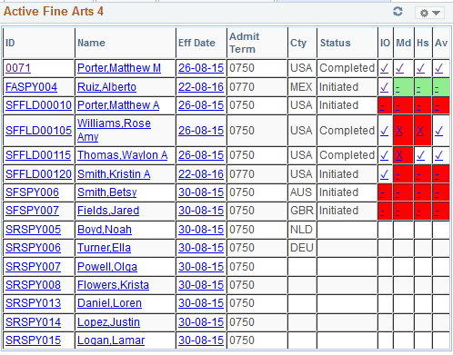
Pagelet with customisations I
First customisation via xslt transformations:
Consolidate checklist item states
Tresholds based on values

Slide 18
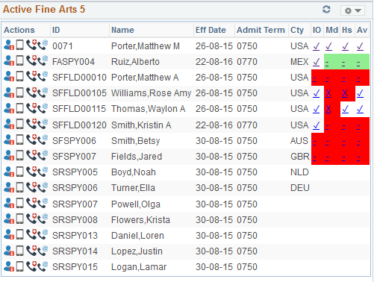
Pagelet with customisations II
Second customisation via xslt transformations:
Images instead of links -> standardised images for same functionality across all workcenters
Easier look & feel (no table cell borders for example, alternate row colors) using css

Slide 19
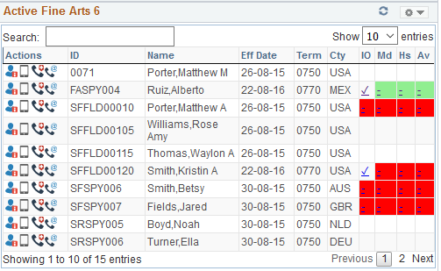
Pagelet with customisations III
Third customisation via xslt transformations:
Custom Javascript component (Datatabels.net) for search, sorting, paging
Also only incompleted checklists are shown

Slide 20
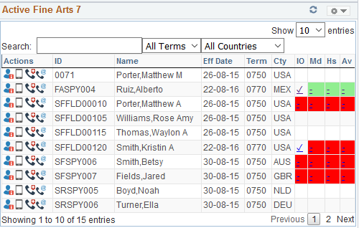
Pagelet with customisations V
Fourth customisation via xslt transformations and the api of the custom Datatables component.
Custom dropdowns based on table data via jquery.

Slide 21
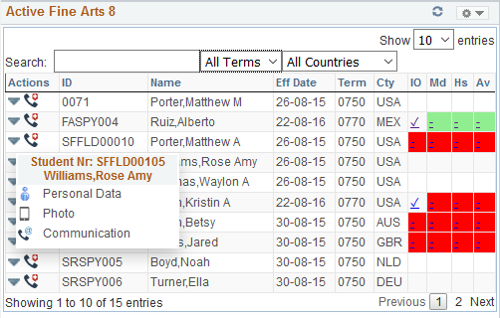
Pagelet with customisations VI
Fifth customisation via xslt transformations:
Using css to create a dropdown with lesser used options and data to maximise screen space.

Slide 22
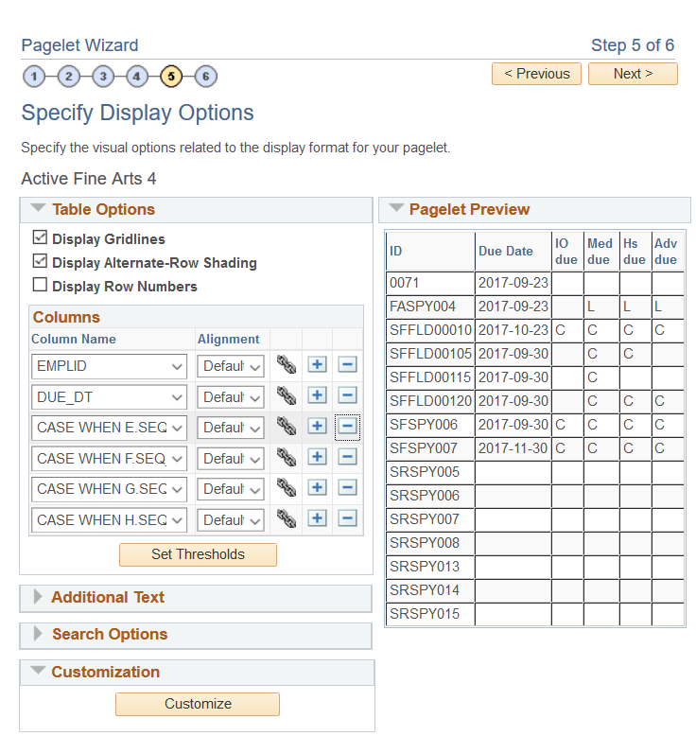
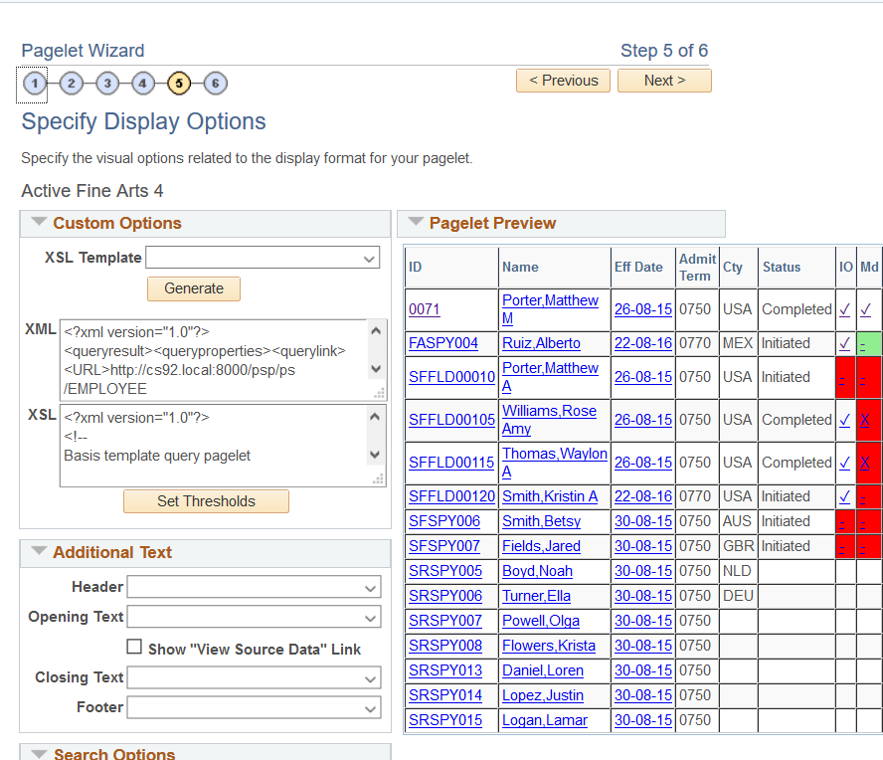
Pagelets: Custom XSL - I

Slide 23
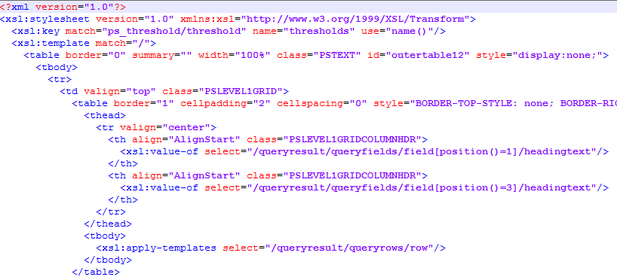
Pagelets: Custom XSL - II

Slide 24
Pagelets: Tips & Tricks - II
Use position based query field access in stead of name based:
<xsl:value-of select="querydata[position()=1]/text"/>
<xsl:value-of select="querydata["EMPLID"]/text"/>
Both methods have advantages and disadvantages.
Position based: when you change the field order in the underlying query, you have to change the numbers in your pagelet.
Name based: when using expressions you need to include the whole expression as the name. With complex expressions and line breaks this is not working well. Also, when a table alias changes the field name changes.

Slide 25
Pagelets: Tips & Tricks - III
Escape ampersand (&) with “&amp;” in links.
Use xslt 1.0 coding, unfortunately the xsl parser is not fully xslt 2.0 compatible (yet?).
Set the Display Format to Custom, this gives you the possibility to write custom xsl code. Tip: first keep the standard ‘Table’ option on Step 4 of the wizard, use the Customise button at the bottom of the page in Step 5. If you choose ‘Custom’ in step 4 you won’t be able to use Thresholds in Step 5.
Use Branding Options to store the custom JavaScript code and css stylesheet.
Use weblibs to include branding and images in the pagelet.
The PeopleSoft xsl parser is rather strict so some code which works in other parsers might not work in PeopleSoft.
Make sure the xsl and html is complete, no missing close tags, etc.

Slide 26
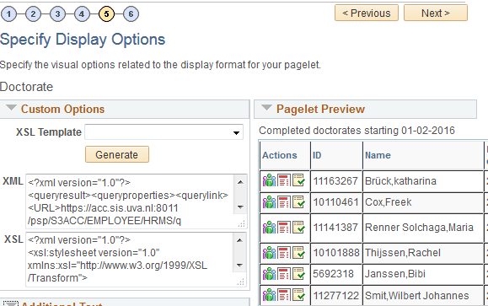
Pagelets: Custom XSL - III
We are using the custom option on the Select Display Option tab so we are able to use custom xsl to generate the layout we desire.
There are a few pre-delivered xslt templates but you can also write your own to get a generic look and feel across all your pagelets.

Slide 27
Branding Objects - I
Via PeopleTools > Portal > Branding > Branding Objects it is possible to store custom JavaScript, CSS and images in PeopleSoft.
You can use these in your customised pagelets via script includes (standard PeopleSoft weblibrary calls).
The images are multi-lingual if needed.
They are secure, only when you have access to the weblibs you can use them.
They are cached until changed. The weblib will automatically cache the item when first called or when it has been changed.

Slide 28
Branding Objects - II
WEBLIB_PTBR.ISCRIPT1.FieldFormula.ISCRIPT_GET_CSS loads a css stylesheet from the system.
<xsl:element name="link"> <xsl:attribute name="rel">stylesheet</xsl:attribute> <xsl:attribute name="href"> /psc/ps/EMPLOYEE/SA/s/WEBLIB_PTBR.ISCRIPT1.FieldFormula.IScript_GET_CSS?ID=U_TABLES_CSS </xsl:attribute> </xsl:element>
WEBLIB_PTBR.ISCRIPT1.FieldFormula.ISCRIPT_GET_JS loads a JavaScript file from the system.
<xsl:element name="script"> <xsl:attribute name="src"> /psc/ps/EMPLOYEE/SA/s/WEBLIB_PTBR.ISCRIPT1.FieldFormula.IScript_GET_JS?ID=U_TABLES_CFG </xsl:attribute> &#160; </xsl:element>
Make sure all the xsl codes within the attribute tags are on one line without carriage returns or additional white spaces.
Also the &#160; code is necessary for to get the link working for JavaScript includes via the xsl parser.

Slide 29
Pagelets: Javascript & CSS
You can use JavaScript and css within your custom component xsl.
When using inline javascript, create complex code might not work well with the PeopleSoft xsl parser. For example, some characters can not be used like:
html characters (specially < or >)
ampersand (&), this need to be replaced by &amp;
unbalanced quotes
Workaround: create a JavaScript include file, upload it via Branding Options and include it in your pagelet xsl code.
When using multiple JavaScript includes, page loading order does matter. Most of the time, putting them in the correct order in the xsl will solve this. If not, other techniques need to be used.
For css, you can use it as inline code or via including a custom stylesheet. Preferably the last as you can reuse it in other pagelets to get a common look & feel.

Slide 30
Pagelets: Images
Custom and standard PeopleSoft images can be used in your pagelets as well.
WEBLIB_PTBR.ISCRIPT1.FieldFormula.IScript_GET_IMAGE gets an image form the system.
<img border="0" alt="Some mouse over text">
<xsl:attribute name="src">/psc/ps/EMPLOYEE/SA/s/WEBLIB_PTBR.ISCRIPT1.FieldFormula.IScript_GET_IMAGE?ID=PS_WCS_ROOT_ICN</xsl:attribute>
</img>
This will display the image
The list of available standard images can be found on any component where you can choose an image, for example the navigation collection setup page. You can also use your own images, they can be uploaded in the branding component.

Slide 31
Pagelets: Dynamic Query Links
Using custom xsl you can link to a query from a link or image click
<xsl:element name="a">
<xsl:attribute name="href"> /psc/ps/EMPLOYEE/SA/q/?ICAction=ICQryNameURL=PUBLIC.MY_QUERY_NAME&amp;BIND1=12345678
</xsl:attribute>
<xsl:attribute name="title">My query displays a lot of data</xsl:attribute>
My query
</xsl:element>
This will generate a link ‘My query’ with a mouse over text and executes the query ‘MY_QUERY_NAME’ with a prompt variable with the value 12345678. This can be for example the EMPLID.
The value of the prompt can be variable form your query data as well so you can have a custom link on each row of data.
Try to avoid using private query’s in workcenters as they might not be accessible to all users.

Slide 32
Pagelets: Dynamic Component Links
<xsl:element name="a">
<xsl:attribute name="href">
/psc/ps/EMPLOYEE/SA/c/CC_BIO_DEMO_DATA.SCC_BIO_DEMO.GBL?EMPLID=<xsl:value-of select="querydata[position()=1]/text"/>
</xsl:attribute>
<xsl:attribute name="title">Personal Data</xsl:attribute>
<img border="0" alt="Personal Data">
<xsl:attribute name="src">/psc/ps/EMPLOYEE/SA/s/WEBLIB_PTBR.ISCRIPT1.FieldFormula.IScript_GET_IMAGE?ID=PT_WF_PERSON</xsl:attribute>
</img>
</xsl:element>
This will generate an image with a link to the Personal data component. The value of the prompt is dynamically for each student from the query result.
Use the full component specification, not the CREF.
You can specify which tab to show:
&amp;Page=MY_PAGE_NAME
And even switch Correct history on:
&amp;Action=C

Slide 33
Pagelets: Mouse Overs
This will generate a fixed text mouse over popup on a field.
<div style="width:100%;" title="Career">
<xsl:value-of select="querydata[position()=6]/text"/>
</div>
This will generate a variable text mouse over popup on a field.
<div style="width:100%;">
<xsl:attribute name="title">
<xsl:value-of select="querydata[position()=38]/text"/>
</xsl:attribute>
<xsl:value-of select="querydata[position()=6]/text"/>
</div>

Slide 34
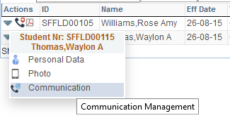
Pagelets: Clickable Images
You can create a clickable image combining the code of the previous slides.
<xsl:element name="a">
<xsl:attribute name="href">
/psc/ps/EMPLOYEE/SA/c/CC_BIO_DEMO_DATA_STDNT.SCC_BIO_DEMO.GBL?EMPLID=<xsl:value-of select="querydata[position()=1]/text"/>
</xsl:attribute>
<xsl:attribute name="title">Personal Data</xsl:attribute>
<img border="0" alt=" Personal Data">
<xsl:attribute name="src">
/psc/ps/EMPLOYEE/SA/s/WEBLIB_PTBR.ISCRIPT1.FieldFormula.IScript_GET_IMAGE?ID=PS_WCS_ROOT_ICN
</xsl:attribute>
</img>
</xsl:element>
Combine several clickable images in a single
table cell to save space and to get rid of
all the ugly blue underlined standard links.

Slide 35
Pagelets: Tresholds
As with normal pagelets, you can set thresholds to apply row or cell colors based on field values in the query.
There is a cave-eat, when you have complex expressions in your query the threshold settings are not always working via the standard functionality, this is a bug and there is no workaround except writing your own threshold coding (see next slide). This also applies to normal uncustomised pagelets.
Make sure when you have a custom xslt the standard threshold xslt parts are included in your code, if not, the thresholds will not work.

Slide 36
Pagelets: Custom Tresholds
With custom pagelets you can even highlight data or cells based on fields not displayed in the grid.
<td> <xsl:choose> <xsl:when test="querydata[position()=37]/text='C'"> <xsl:attribute name="style"> background-color:red; </xsl:attribute> </xsl:when> <xsl:when test="querydata[position()=37]/text='S'"> <xsl:attribute name="style"> background-color:orange; </xsl:attribute> </xsl:when> <xsl:otherwise/> </xsl:choose> </td>
Tip: use the query to do complicate calculations and return a simple code to set the format. For example: if you want all enrollments between 1 jan and 31 aug without a specific checklist, to highlight in red, create an expression in the query which returns Y or N.

Slide 37
Pagelets: Custom Components - I
You can use custom JavaScript components which you can download from the internet. A few things you have to keep in mind:
Put the JavaScript and css inside PeopleSoft, do not link to an external website. For security, availability and performance reasons.
Make sure the component has decent support and development and a active community.
When using a custom sorting/ordering component, set the MAXROWS in the pagelet wizard to 99999 to make sure all data is available.
Take into account the underlying query might get slow with many rows to fetch. Try to optimise your query for this.

Slide 38
Pagelets: Custom Components - II
We are using a custom JavaScript component to enhance the standard pagelet usability. This adds the possibility to sort, filter, paginate, etc. the data. We are using DataTables, this is a free open source project with a decent development team.
https://www.datatables.net/
DataTables comes with a JavaScript and a css stylesheet, customisations and overrides are done in a separate file. Also this component needs a newer version of Jquery as comes with Campus so this is included via a branding option as well. It also has a library of plugins and a useful api.

Slide 39
Pagelets: Datatables custom component
With this component you can do a lot of things:
Sorting
Paging
Filtering
Hide columns
Group column data in dropdowns via the dataapi and jQuery.

Slide 40
Workcenters: 9.2
In 9.2 Enterprise Components will give you a new type of WorkCenter and new types of pagelets:
My Work: a list with to-do items. Needs a custom PeopleCode component to work
Links: Links to components
Queries: list of query’s
Reports/Processes: list of reports
Items can be added centrally or by the user.
Filter/Scope options gives the functionality to set default values, runcontrols, etc. for the pagelet items. These can be grouped in sets to switch easily to another set of prompt values.
Available for classic workcenters and fluid. In classic they can be combined with other pagelets, in fluid you just have the new Enterprise Components pagelets.
Fluid workcenters: basically this needs a lot of custom PeopleCode to get it working. Only the standard Enterprise Component pagelets are out-of-the-box available.

Slide 41
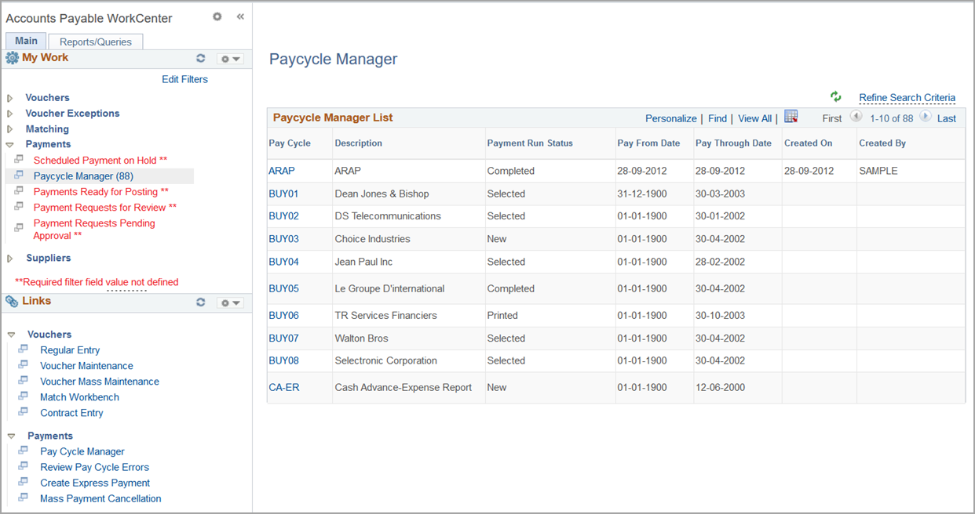
9.2 Classic Workcenter

Slide 42
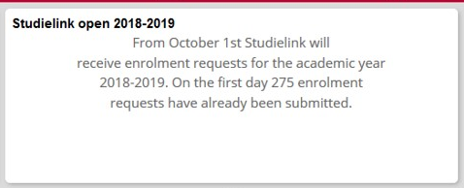
Fluid Homepage: Dynamic tiles
Dynamic content on home page tiles.
This can be done via the tile wizard, but lot of issues… For example, tile wizard is not multi-language, to access static content tiles created via the tile wizard you need way too much authorization roles, etc.
Workaround
Create a pagelet and put it on a tile!
Via a custom xsl pagelet you can get all the data on a tile you ever wanted.

Slide 43
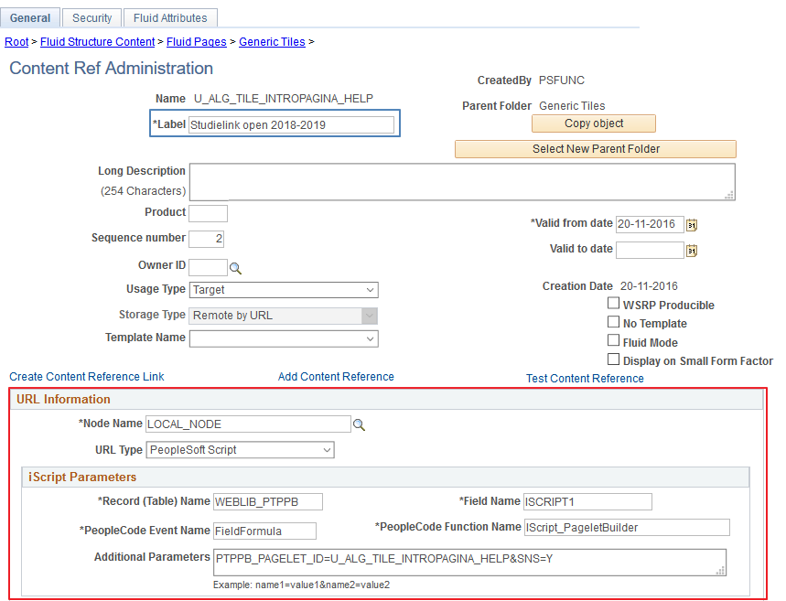
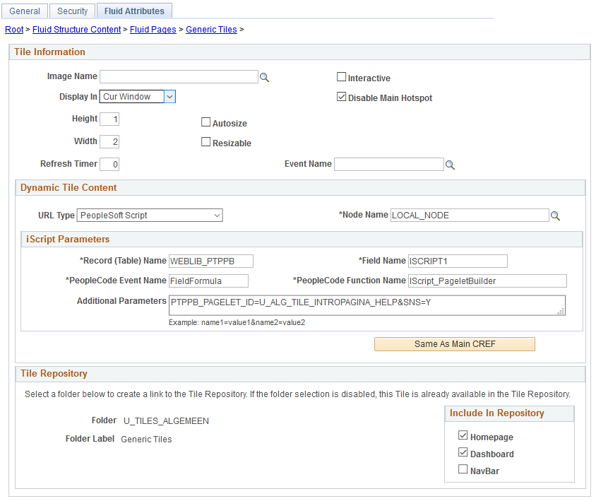
Fluid Homepage: Dynamic tiles

Slide 44
Usefull menu items
Main Menu > PeopleTools > Portal >
> Branding > Branding Objects
> WorkCenter
> Portal Utilities > Navigation Collections
> Pagelet wizard
> Structure and Content
> Inter Window Communication

Slide 45
Questions?

Slide 46
Mark van der Molen
Senior Functional Application Manager
University of Amsterdam
m.vandermolen@uva.nl
Carolien ten Oever
Senior Functional Analyst
University of Amsterdam
c.a.m.tenoever@uva.nl

Slide 47
Complete your session survey!
Open the HEUG Events App on your phone, tablet, or laptop
Click on this session in your schedule.
Then click the "Resources" button and "Survey“ You will be required to login once with your Eventsential username and password.

Slide 48
This presentation and all Alliance 2018 presentations are available for download from the Conference site at www.alliance-conference.com

